Slide 1
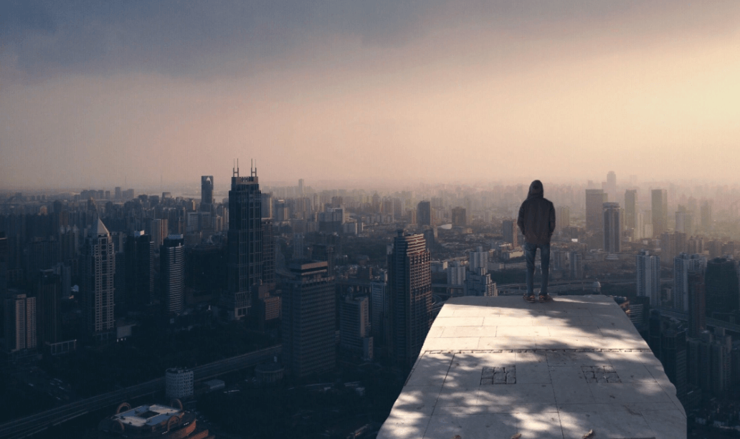
We would settle in a big city

Slide 2
Ⅰ Environment
Ⅱ Transportation
CONCENTS
Ⅲ Opportunities
Ⅳ Culture

Slide 3
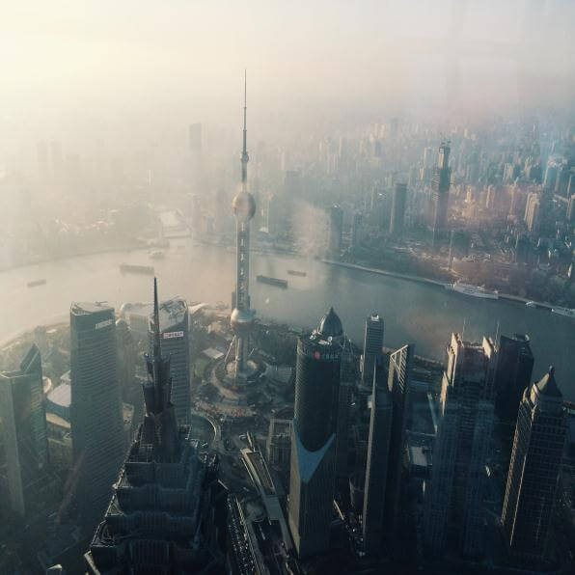
01
Environment

Slide 4
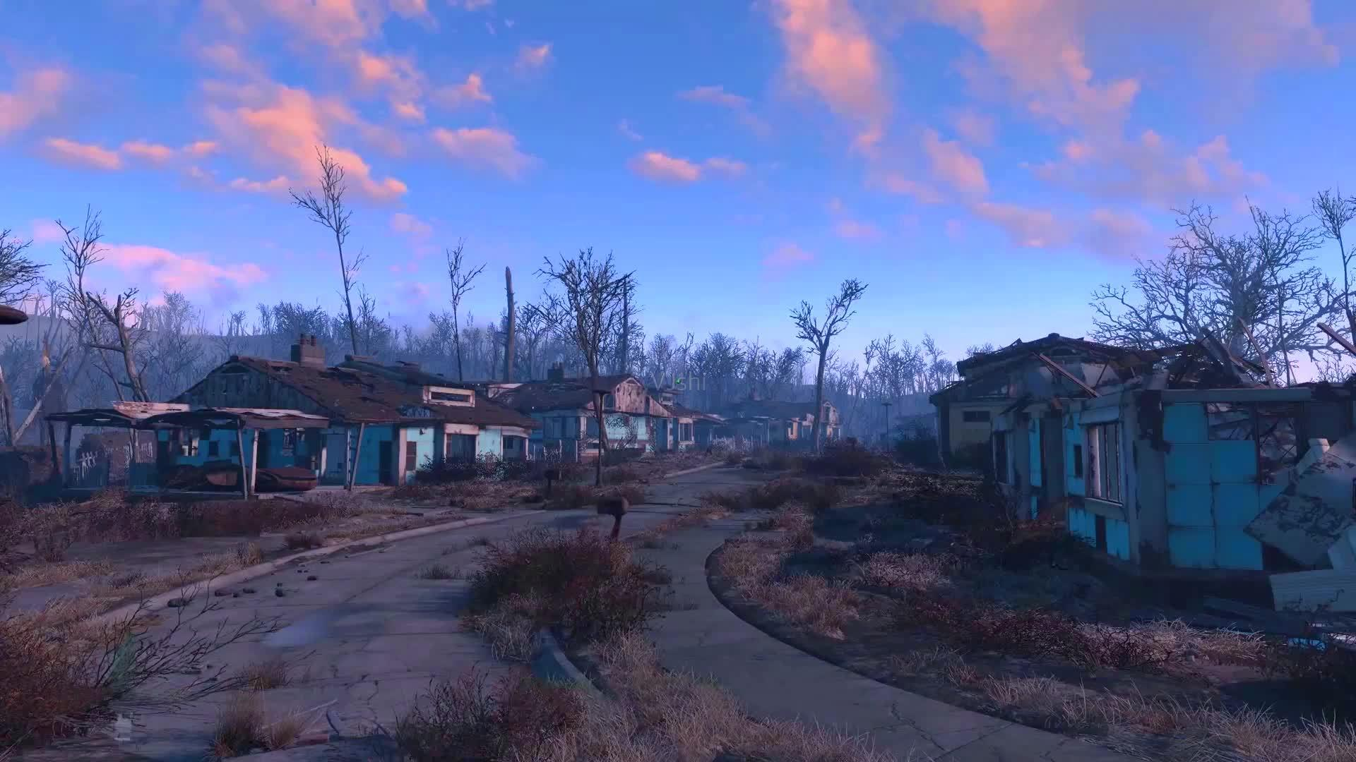
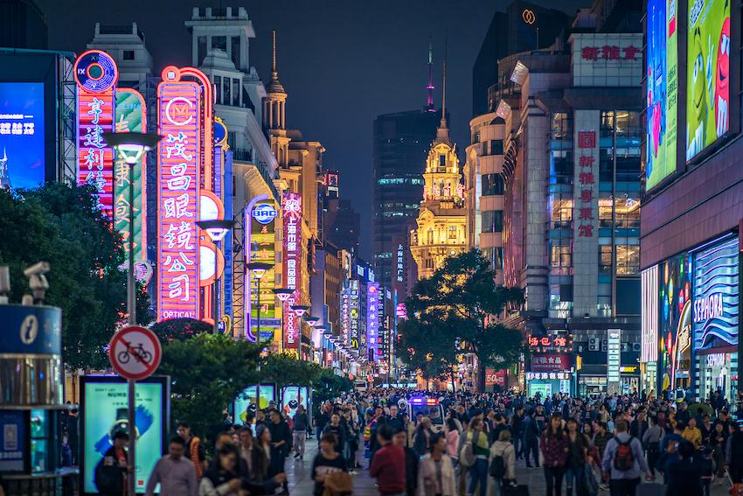
Environment
Small towns in the suburbs are not like the center of the city, where has restaurants, supermarkets, foodmarkets and so on everywhere.
life in big cities is very convenient

Slide 5
02
transportation

Slide 6
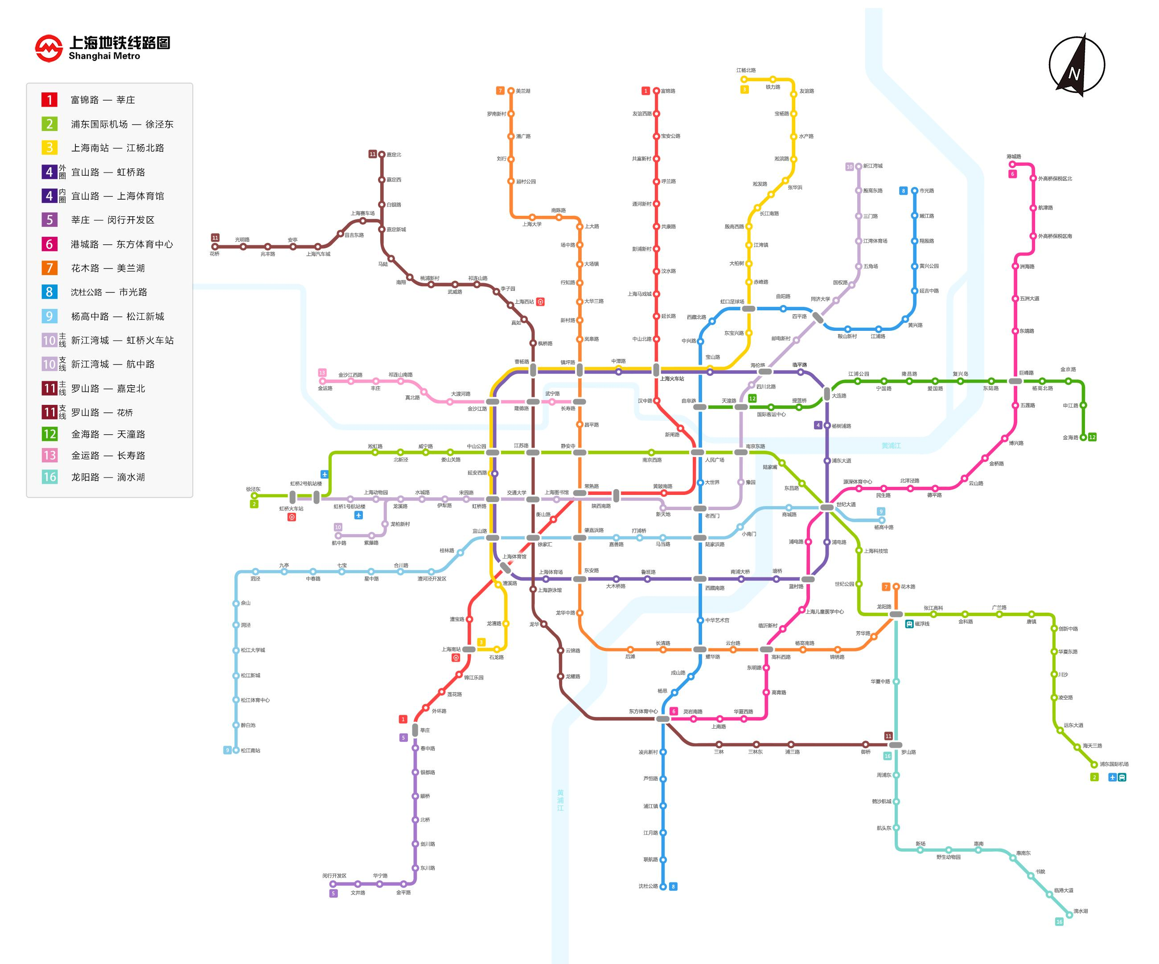
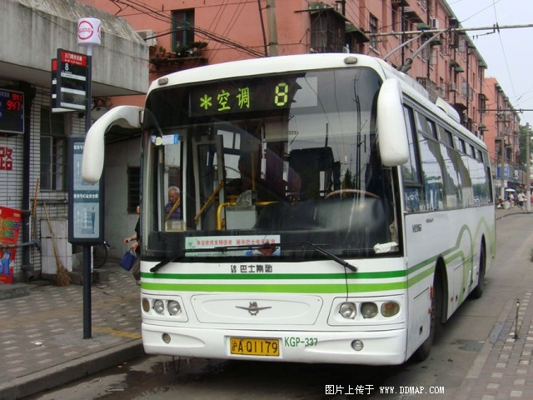
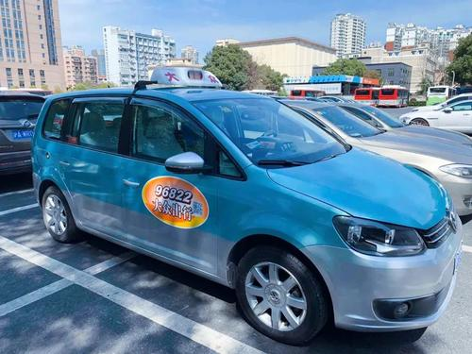

Transportation
public transportation
more choices

Slide 7
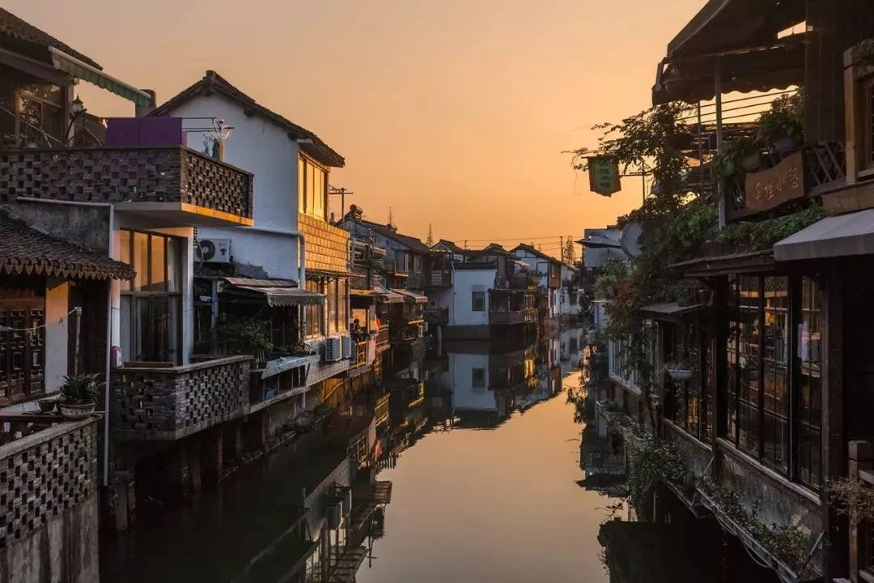
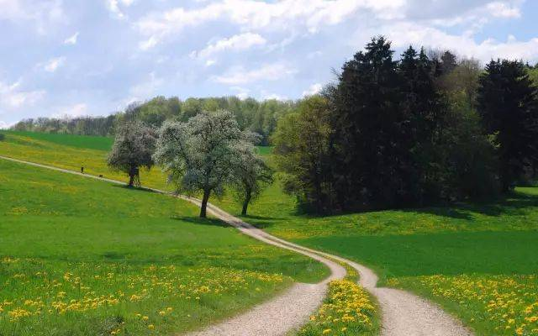
Efficiency
此处添加详细文本描述，建议与标题相关并符合整体语言风格，语言描述尽量。……
acient town
A
traffic in big city
此处添加详细文本描述，建议与标题相关并符合整体语言风格，语言描述尽量。……
B
此处添加详细文本描述，建议与标题相关并符合整体语言风格，语言描述尽量。……
country road
C

Slide 8
03
Opportunities

Slide 9
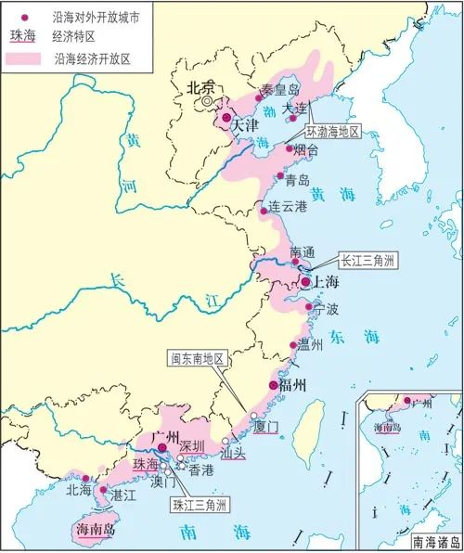
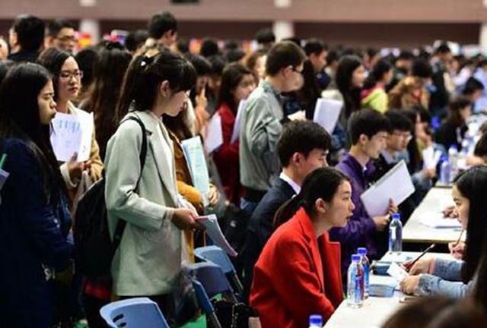
Big cities’location attracts people
big cities located near the sea
many people come here for living
Notes:
https://www.ypppt.com/

Slide 10
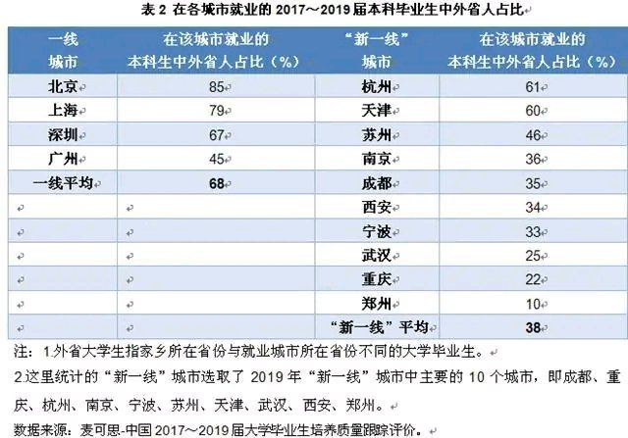
Excellent people makes you a better man
You have to work hard to compete with others

Slide 11
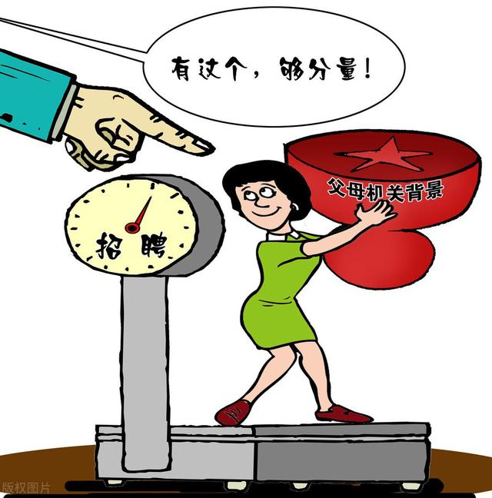
Family relationship
There is a phenomena that more and more people in China get their jobs through their family relationship.

Slide 12
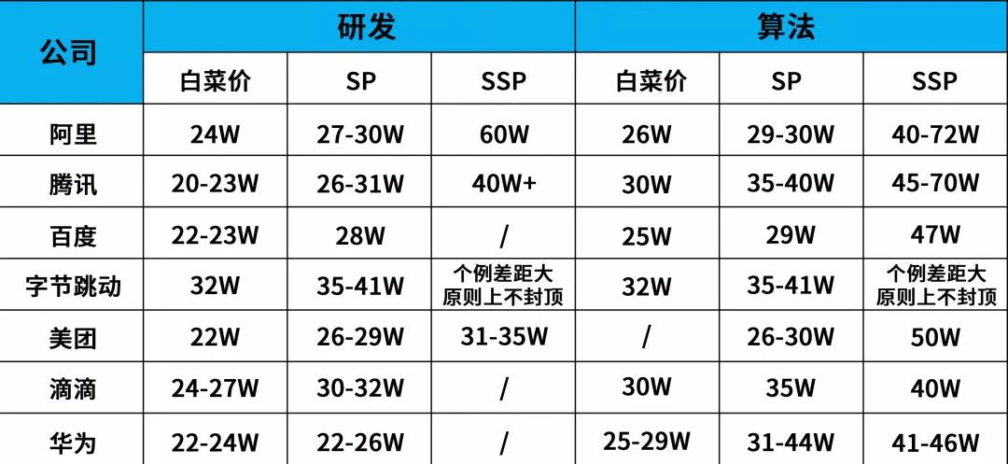

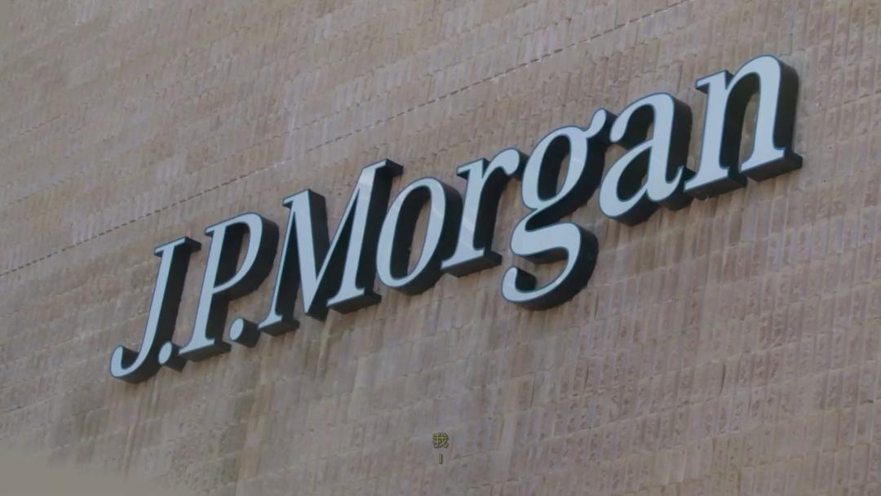

Big companies
The biggest advantage that staying in big cities is that you can find a job in big or international companies like Byte Dance、Tencent and JPMorgan.Working in these companies means that you may get one million a year.

Slide 13
04
Culture

Slide 14
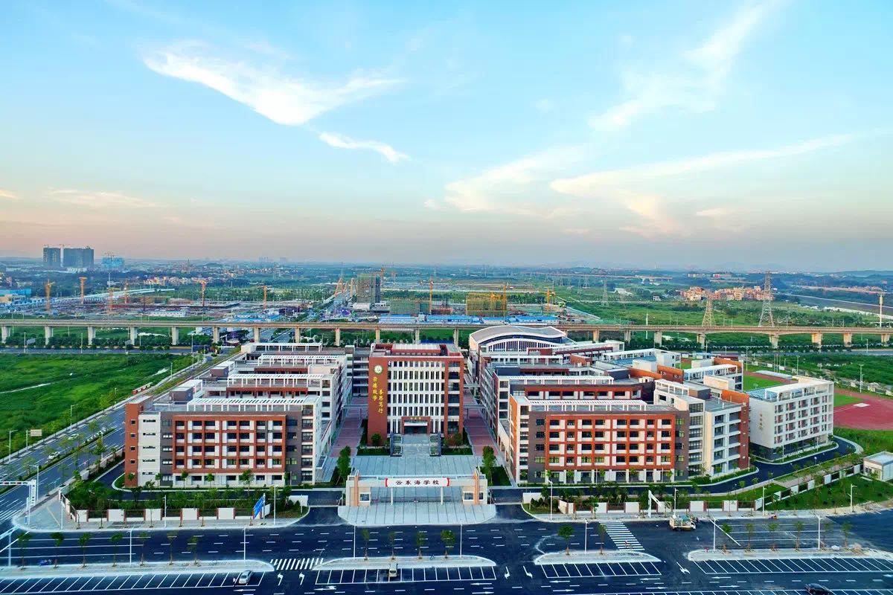
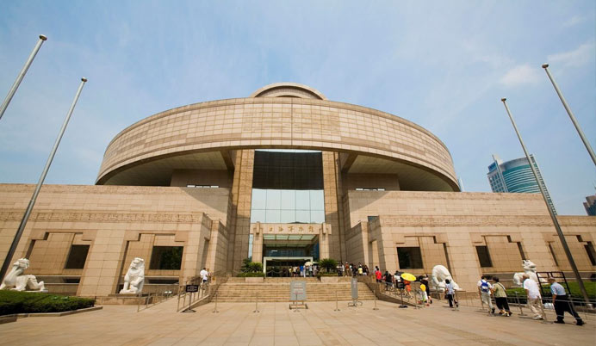
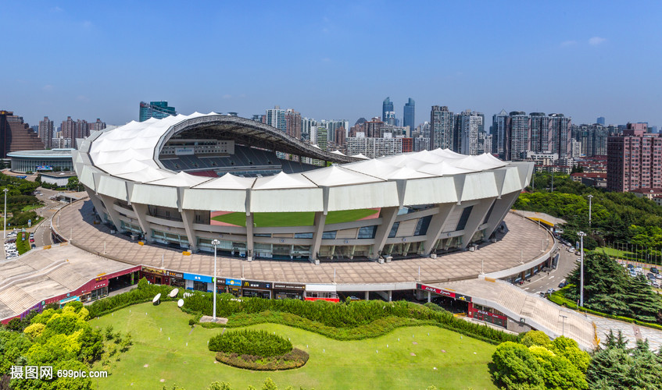
Outline
Educational Institutions
Cultural Atmosphere
Cultural Facilities

Slide 15
Thanks for listening

